Slide 1

National Institute of Technology Calicut
NITC RESOURCE MANAGEMENT SYSTEM
Project Owner: BHIMAVARAPU MANOGZNA
CREATED BY
JUNAID ANSARI
ARJUN BHARDWAJ
RAKHI KUMARI

Slide 2
ABOUT
A resource management registrar is a system or organization responsible for maintaining a database of resources, such as equipment, personnel, or materials, and their availability for use.
This can include scheduling and allocation of resources, as well as tracking and reporting on their usage.
Tools and Technology Used : Android using Java language
Scope of the Project : Can only accessibe to NITC students/faculty

Slide 3
WHAT FUNCTIONALITIES OUR SYSTEM CAN PROVIDE?
The system allows a user to Register.
The system allows the user the log in.
The system allows the user to view the resources.
The system allows the user to take resources.
The system allows the user to lodge a complaint.
The system allows the user to renew the resources
The system allows the user to edit the profile.
The system allows the user to view his/her complaints.
The system allows the user to view his/her occupied resources.
The system allows the admin to add resources.
The system allows the admin to manage the resources.
The system allows the admin to fulfill the user requests/complaints

Slide 4
LETS’S DEEP DIVE INTO OUR APP.

Slide 5
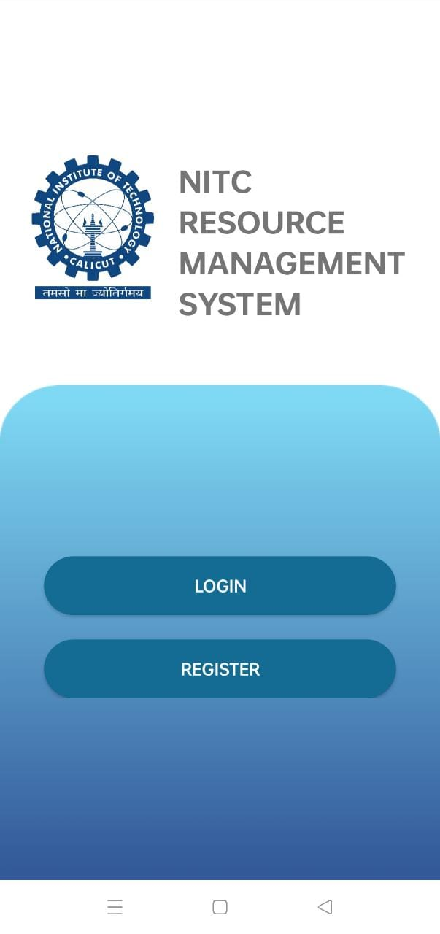
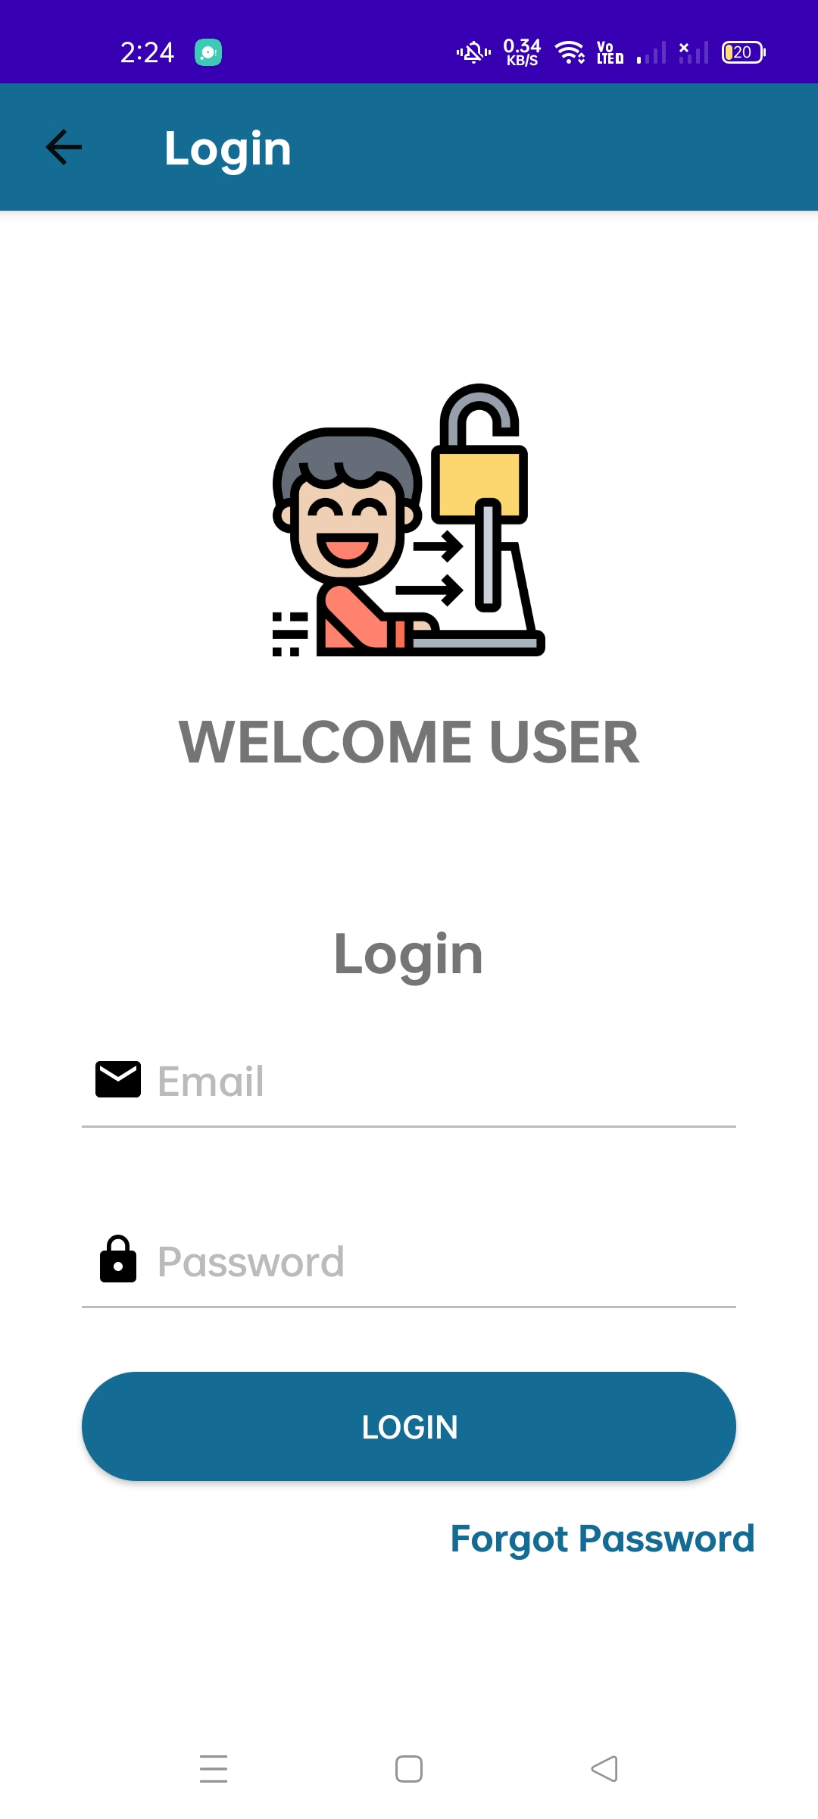
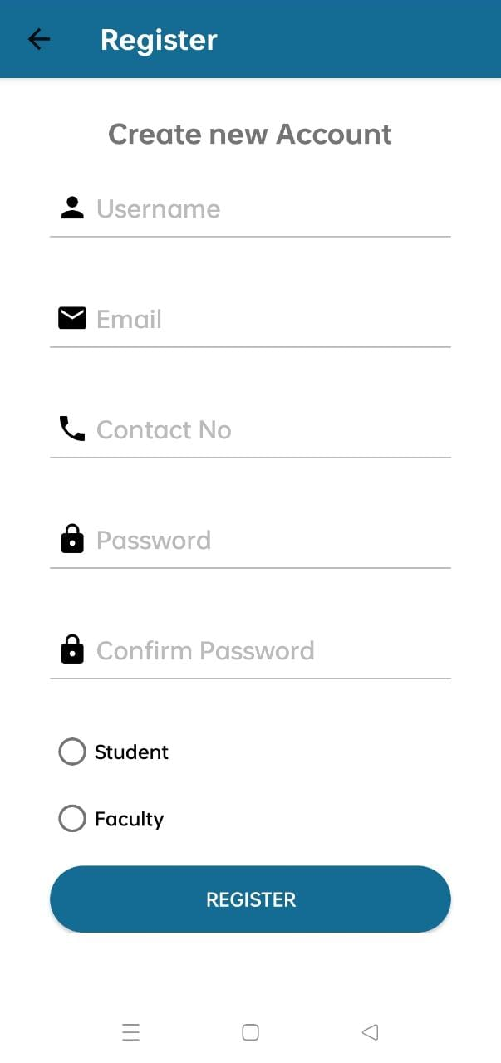
USER INTERFACES
We have admin and user as users here.
These are the common interface for both the admin and the user.
1. The login page
2. The Register page.

Slide 6
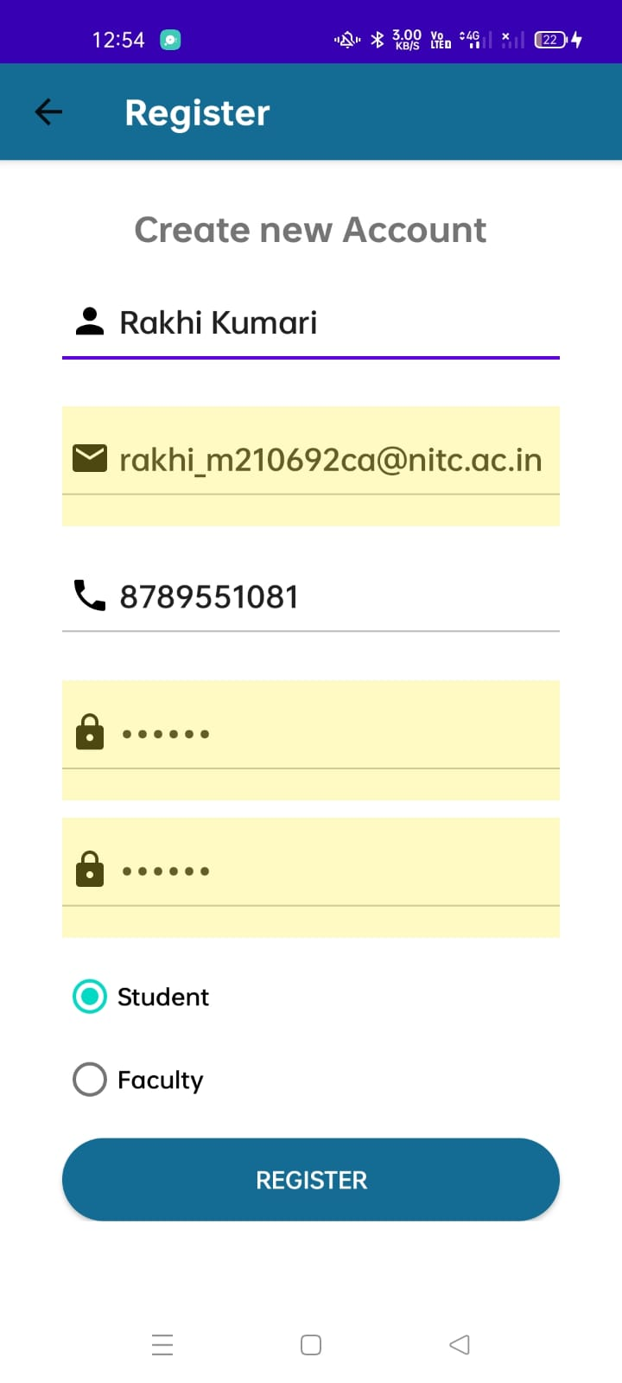
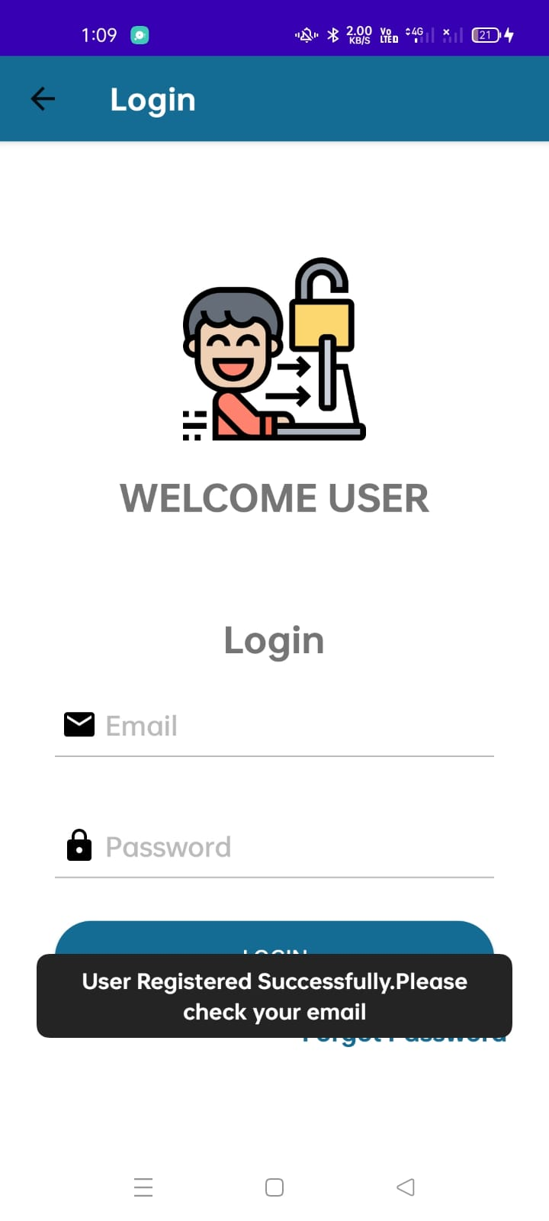
REGISTER PAGE
Directed to login page after a successful registration.
Register outline
Fields Entry
Once the fields are filled correctly a verification link is sent to the entered mail.
Until it’s verified users can’t log in to the system.

Slide 7
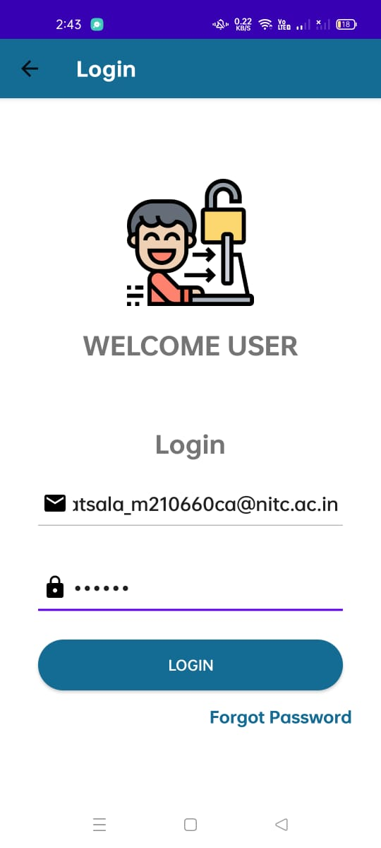
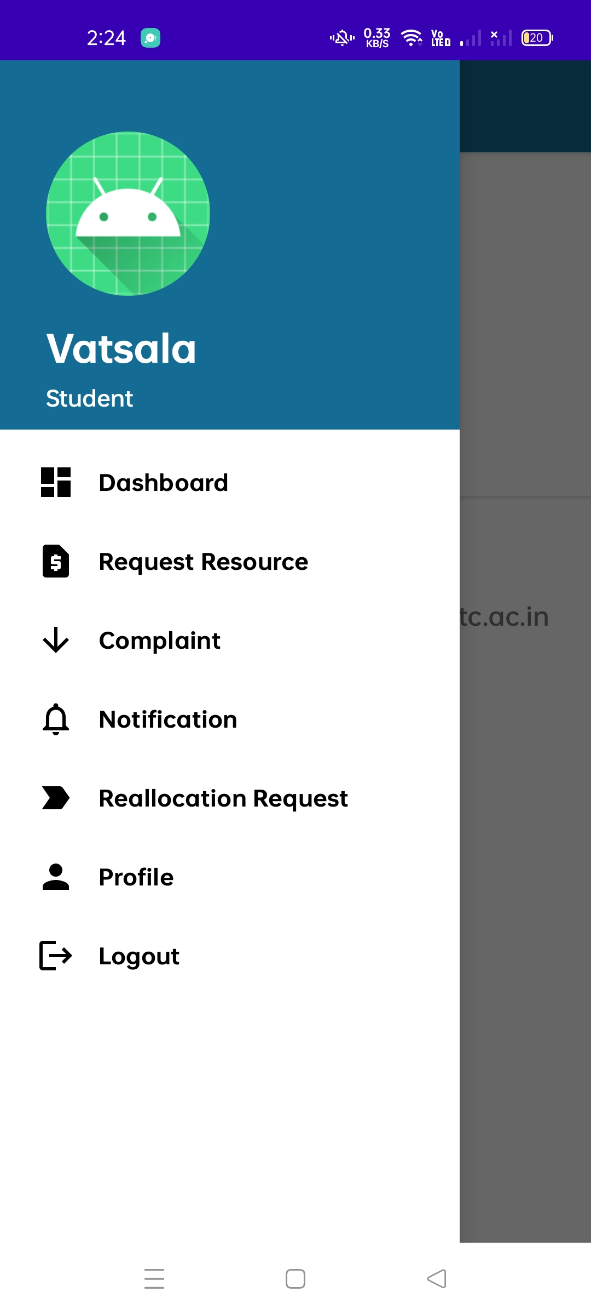
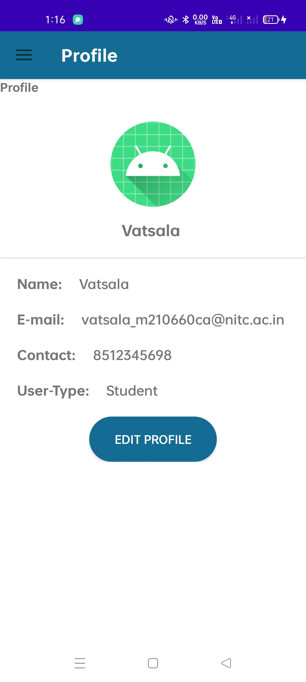
LOG-IN PAGE FOR USERS
User logging in
User Home Page
User profile

Slide 8
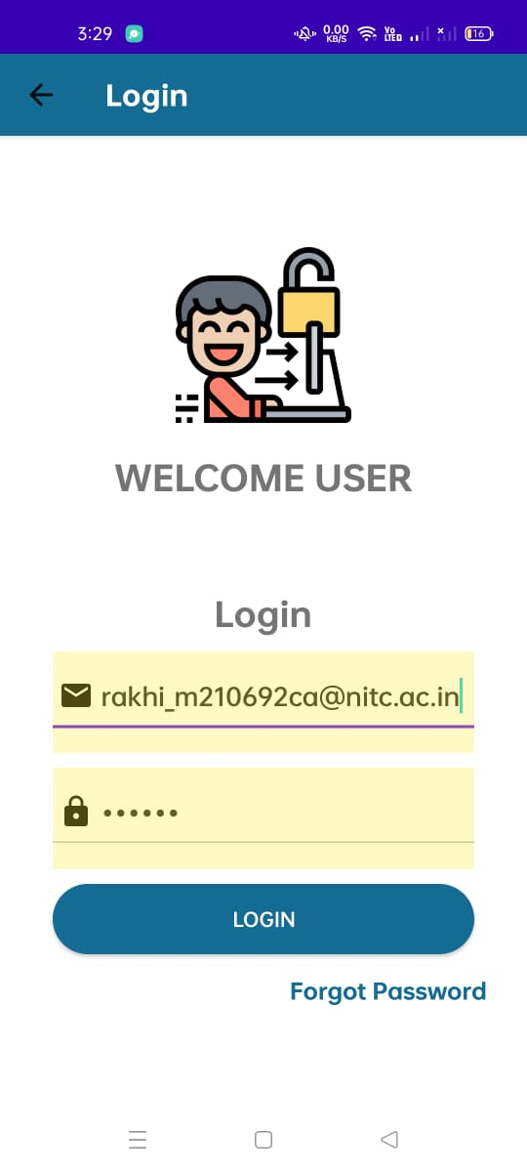
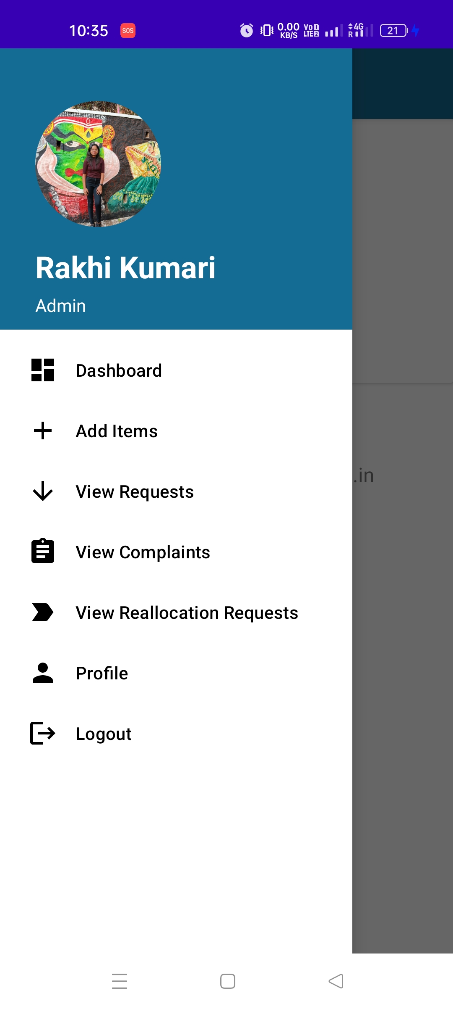
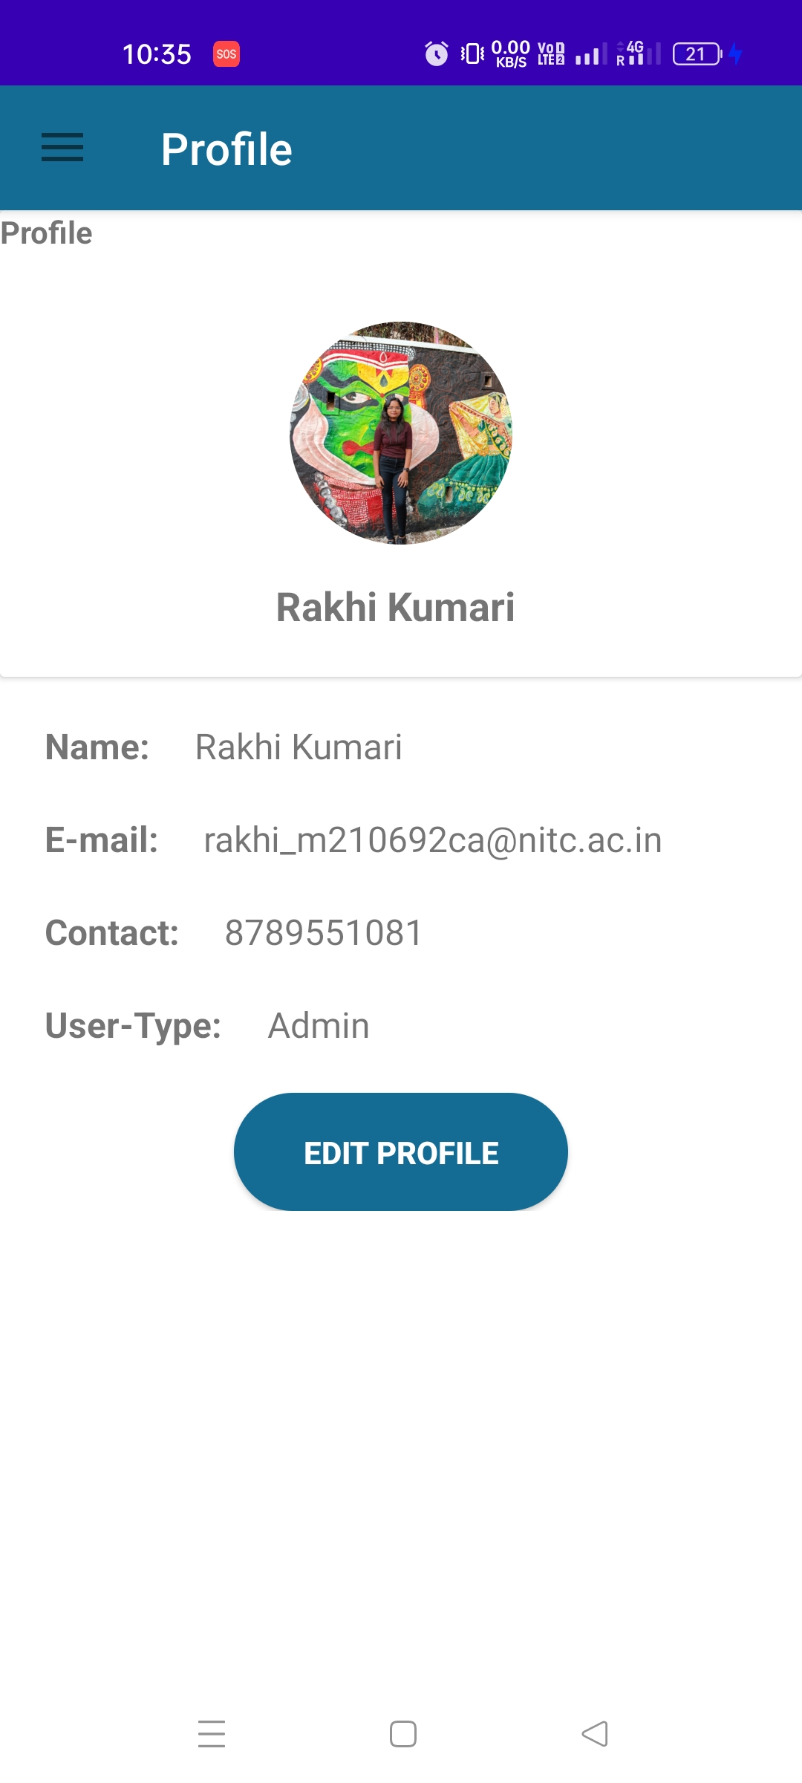
LOG-IN PAGE FOR ADMIN
Admin logging in
Admin Home Page
Admin Profile

Slide 9
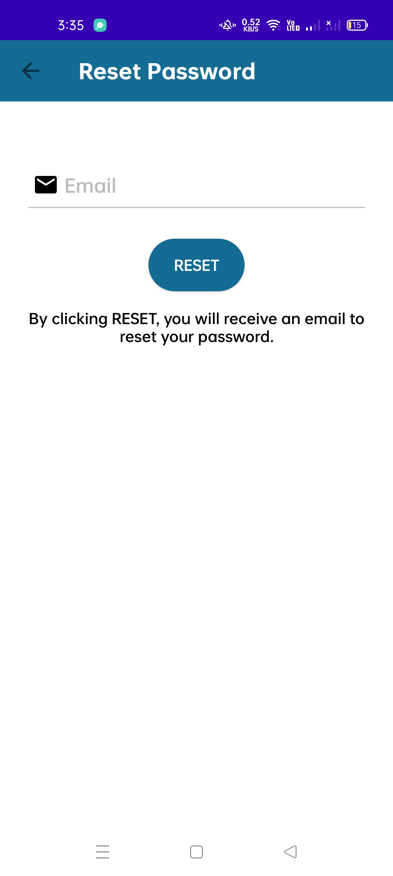
Users can reset password if forgot.

Slide 10
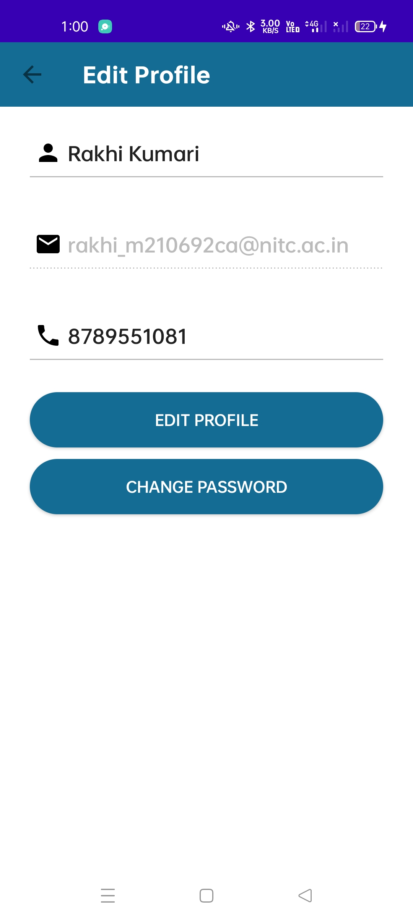
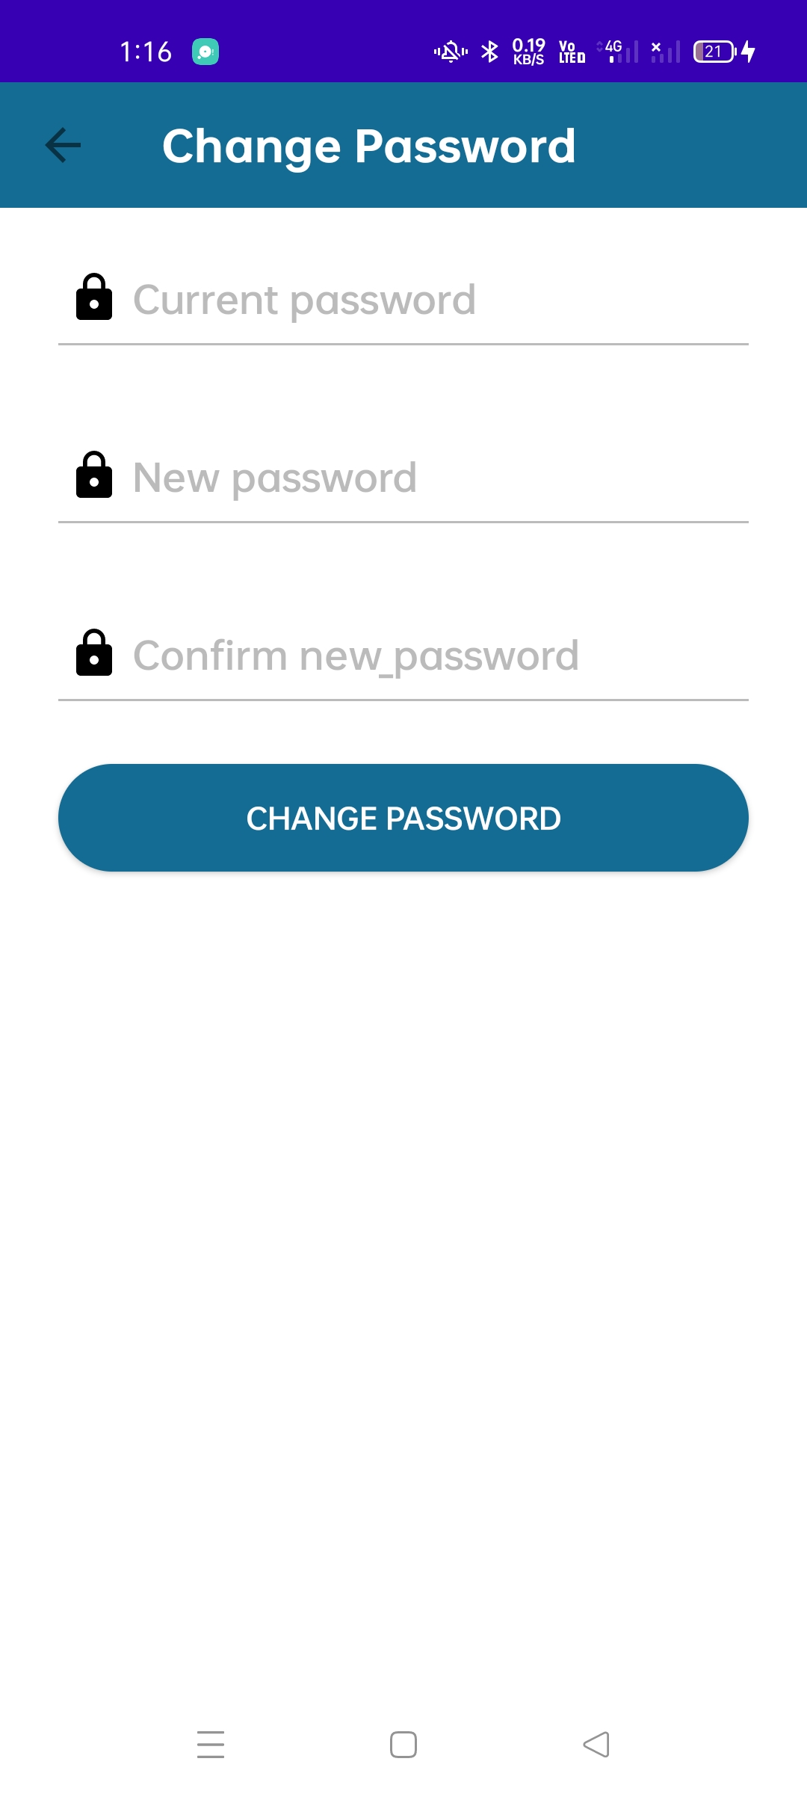
Users can edit their profile if wants to.

Slide 11
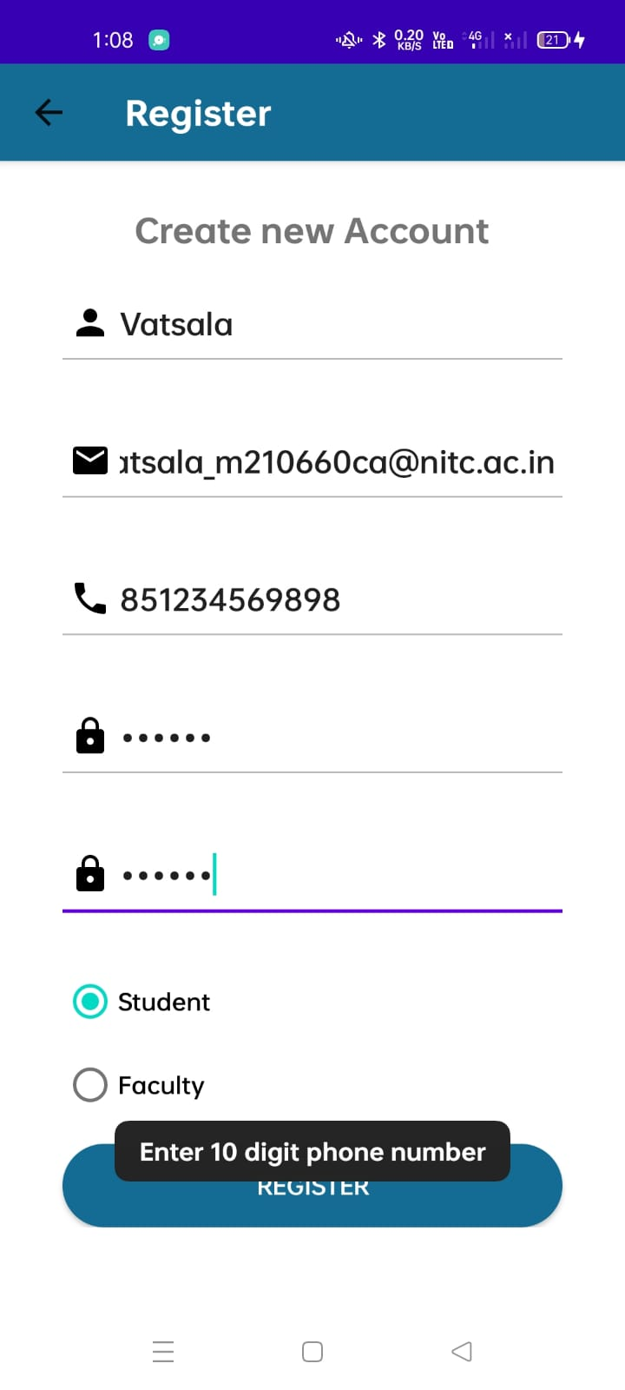
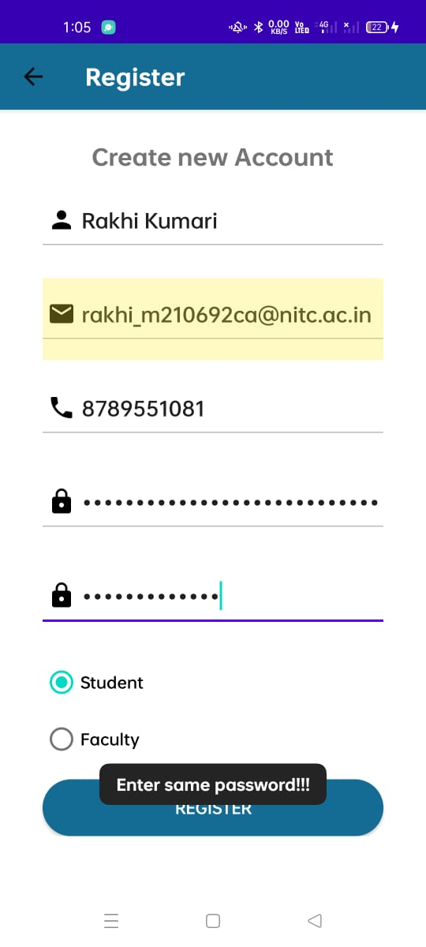
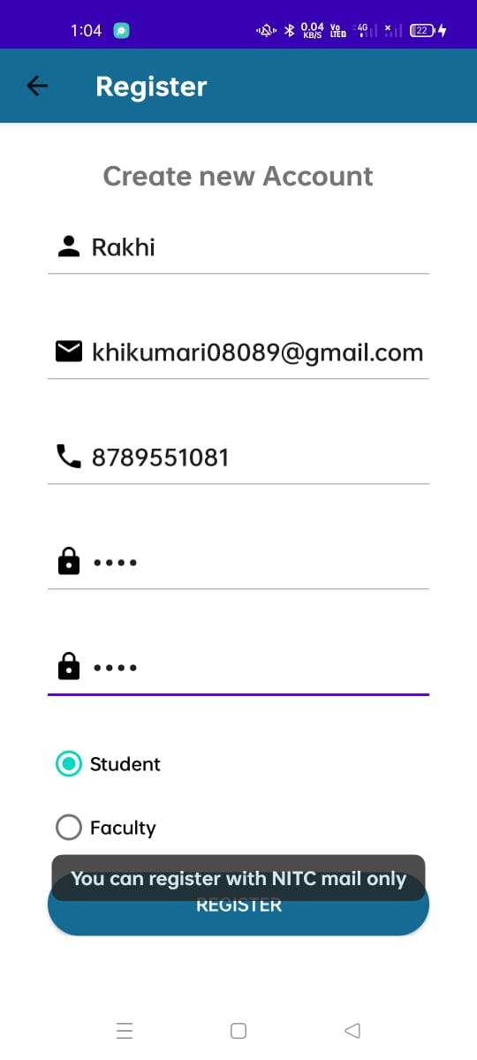
Examples of Some of the handled corner cases
a. Entering a number less than 10 digits.
b. Entering mismatched password
c. Allowing only nitc mail id.

Slide 12
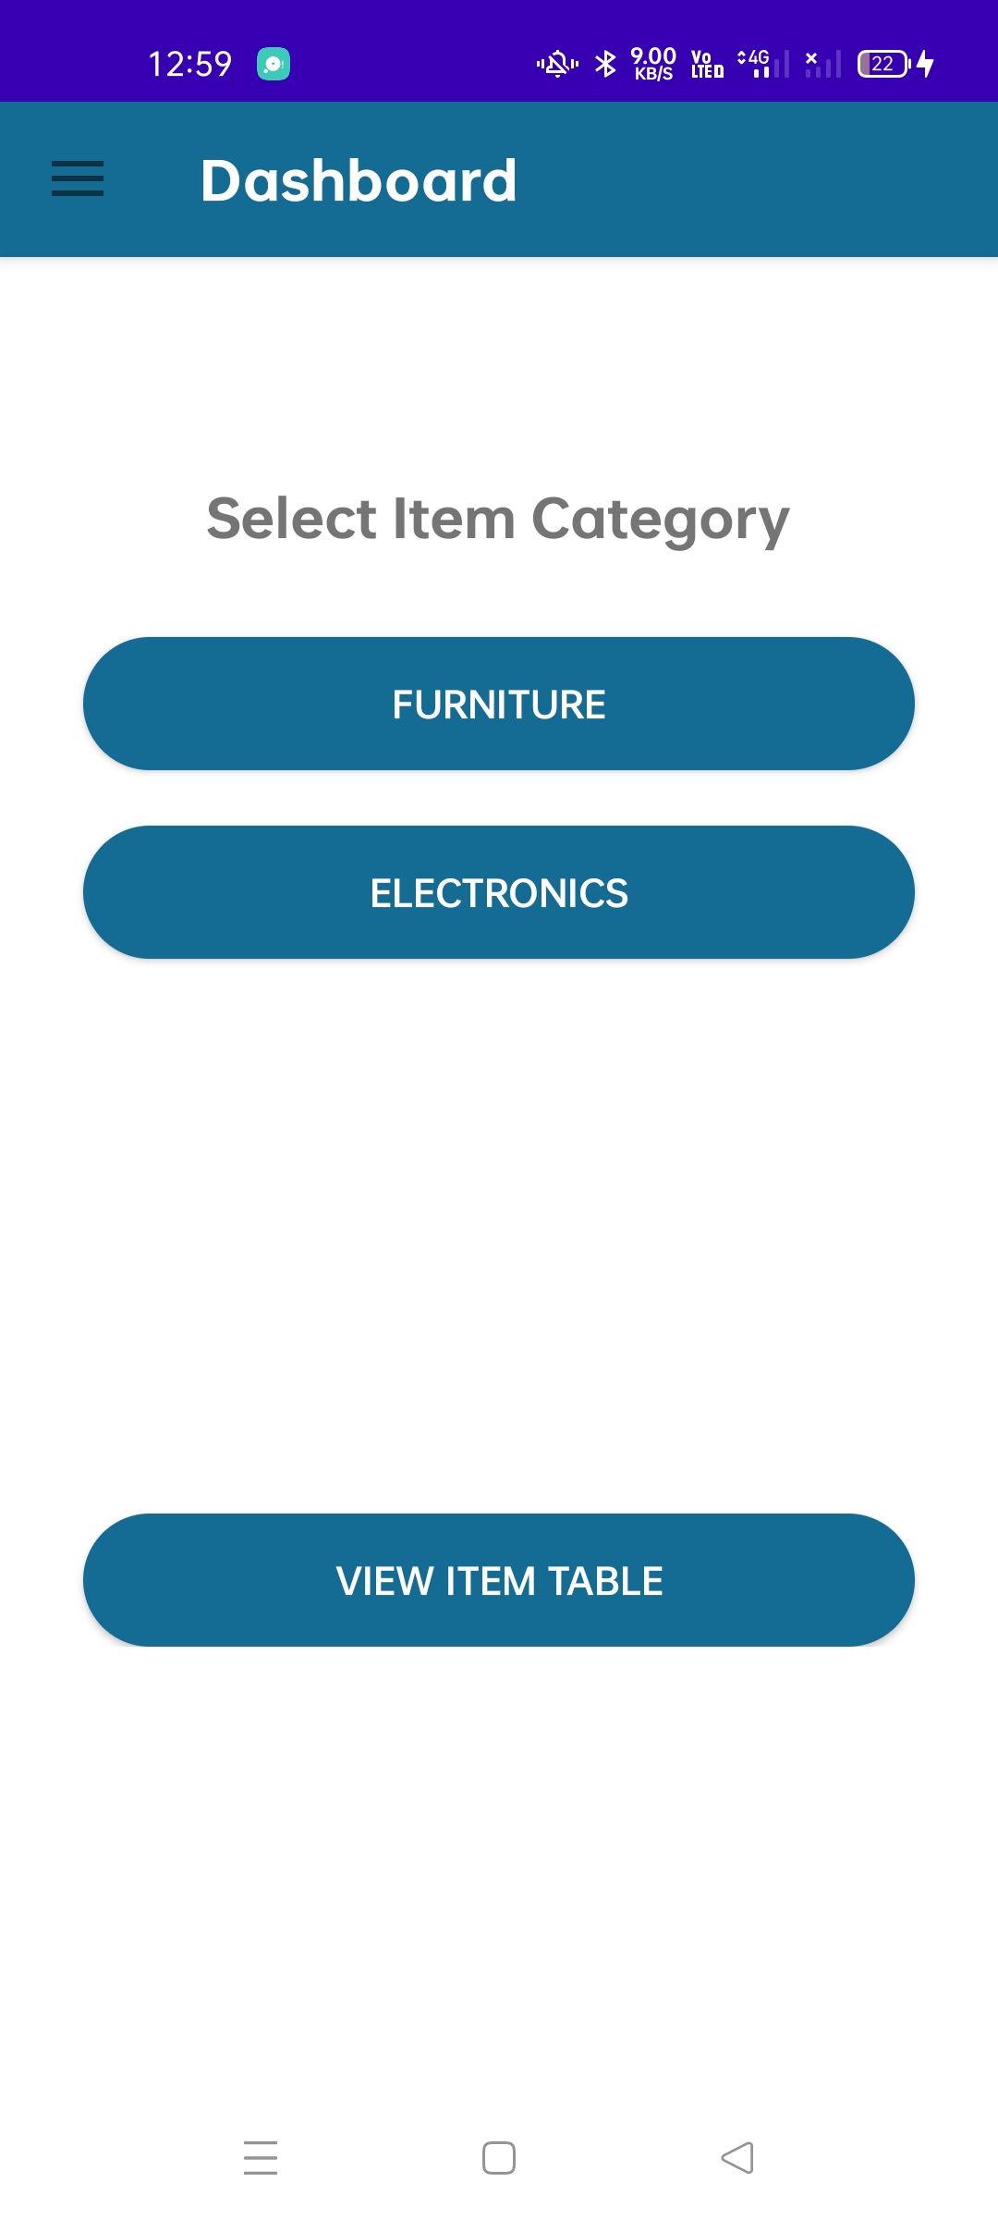
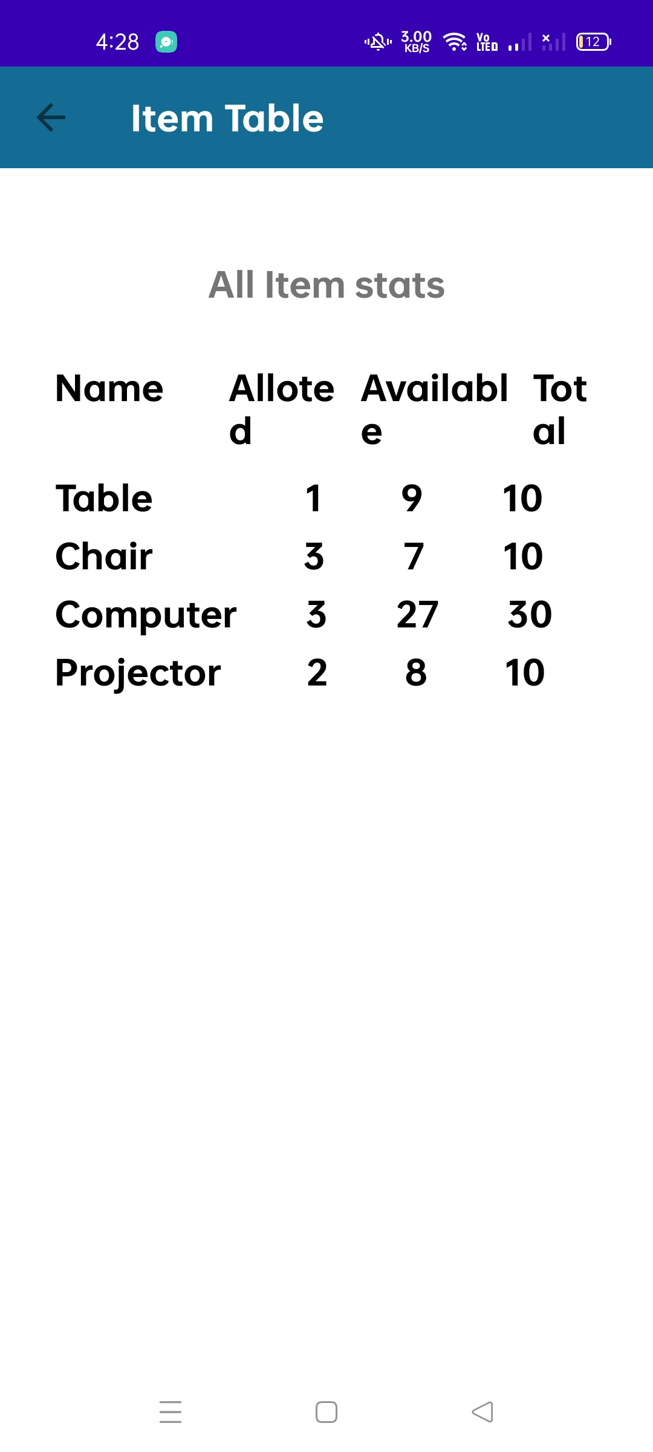
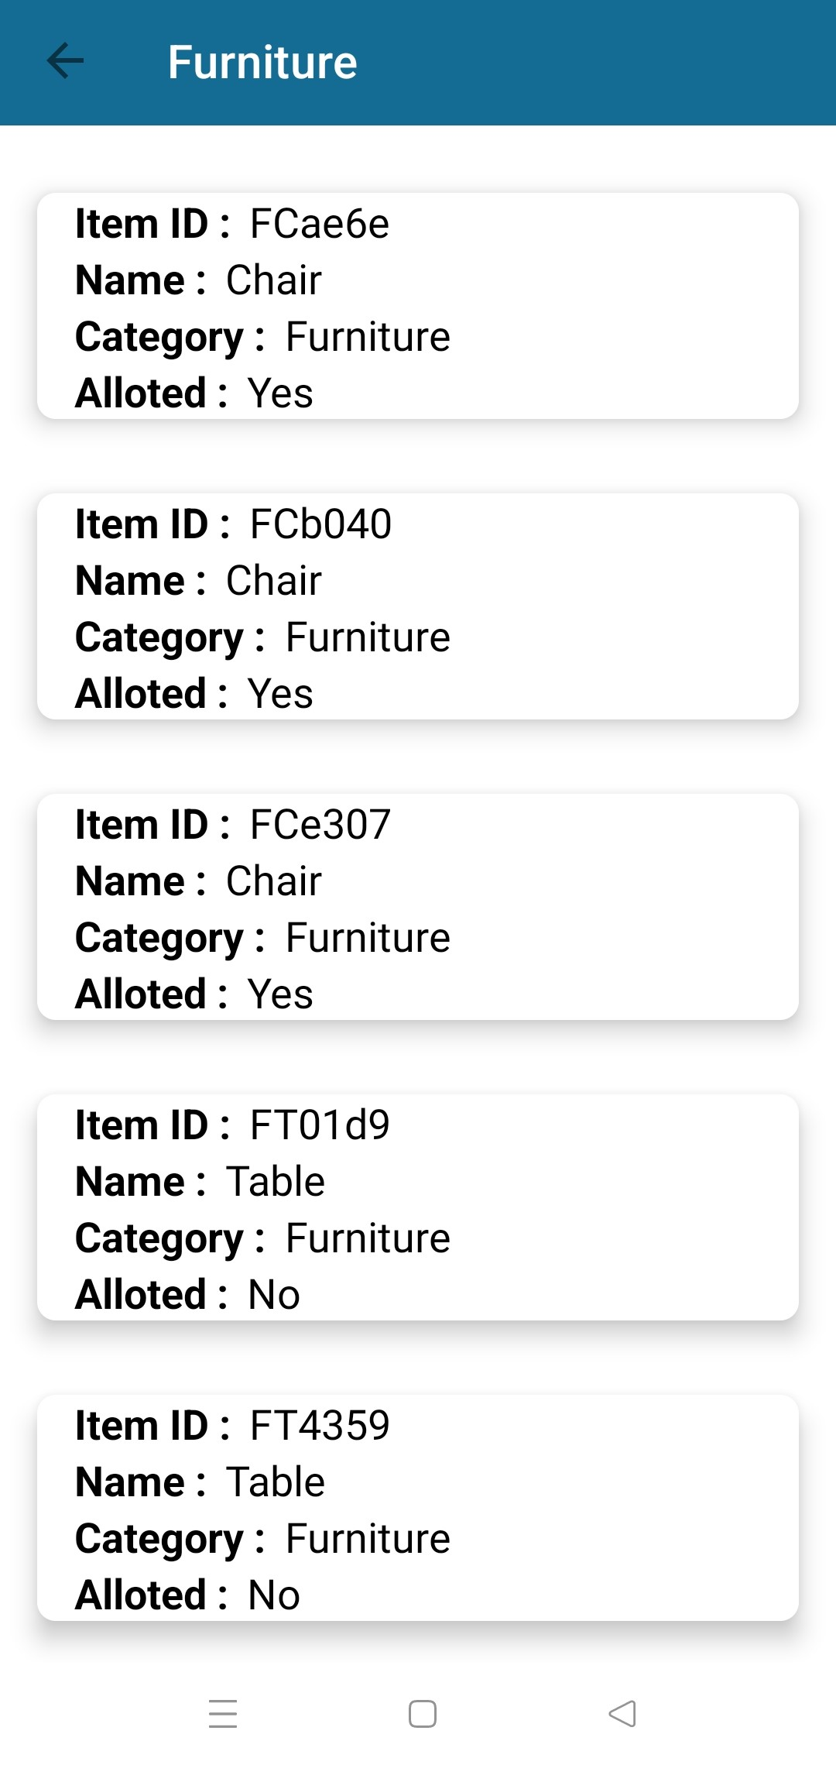
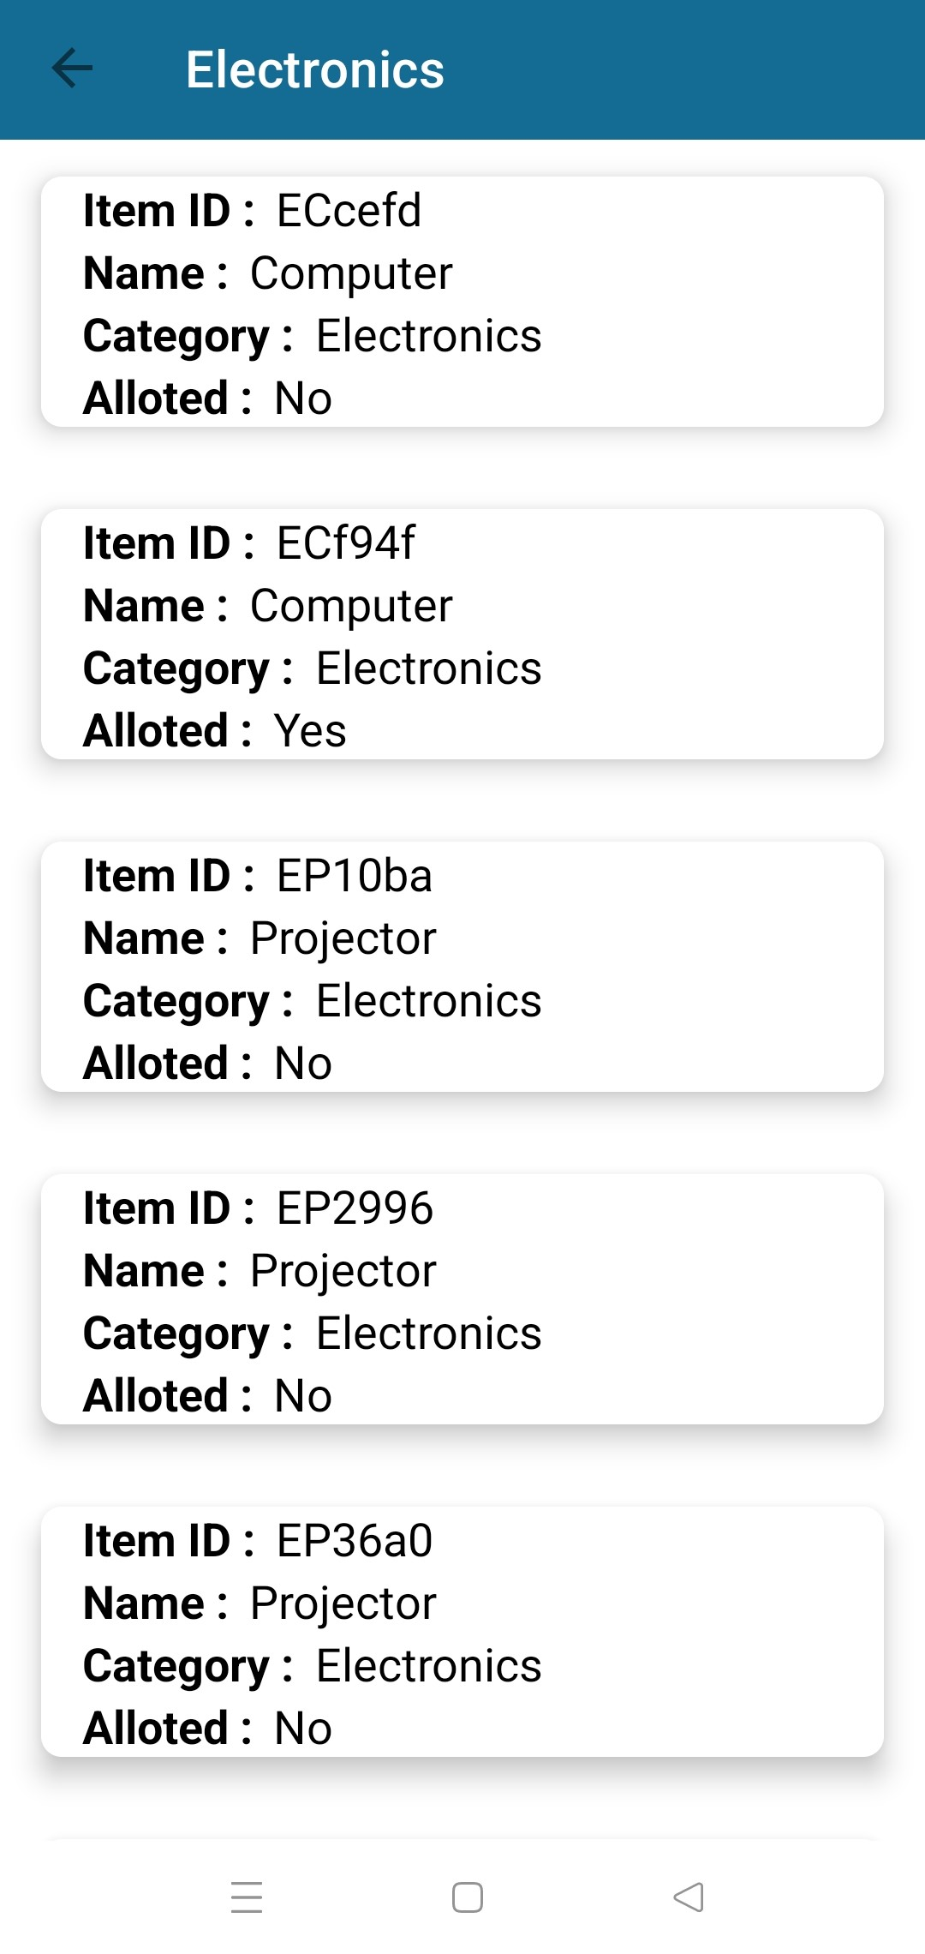
DASHBOARDS
ADMIN DASHBOARD
1.Admin can view the item category, item name, and item id and can also see its allotment status that is if the requested item is allotted or not. This will be appearing on the admin’s dashboard.
2. Item availability stats and allotted item stats have been maintained in the item table which the admin can refer to.

Slide 13
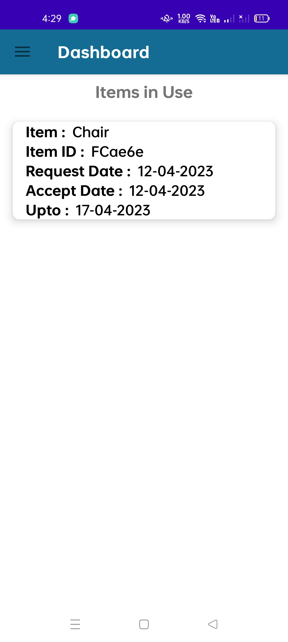
DASHBOARDS
USER DASHBOARD
User can view the details of the item that are in use. Such as item name, date of request,date of when it was accepted, and till when it can be used.

Slide 14
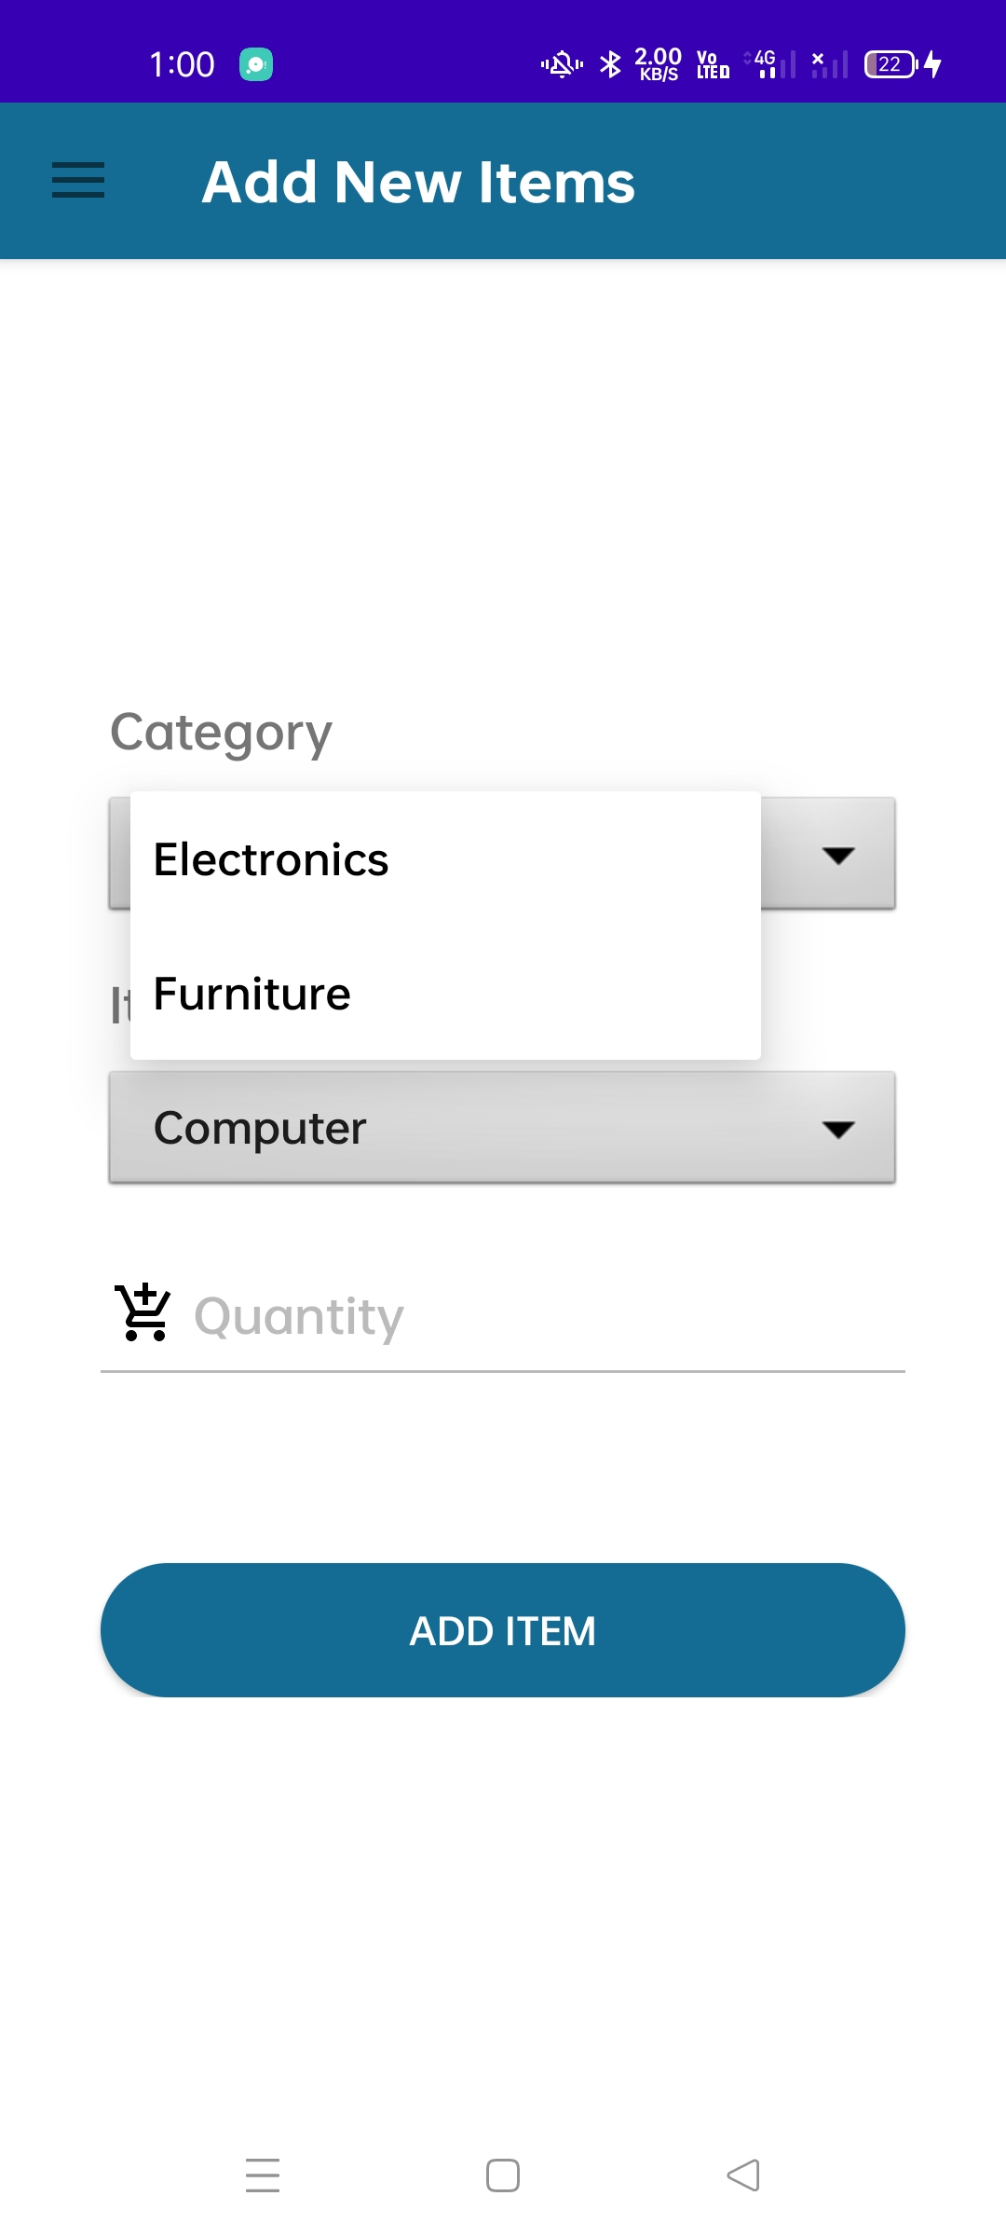
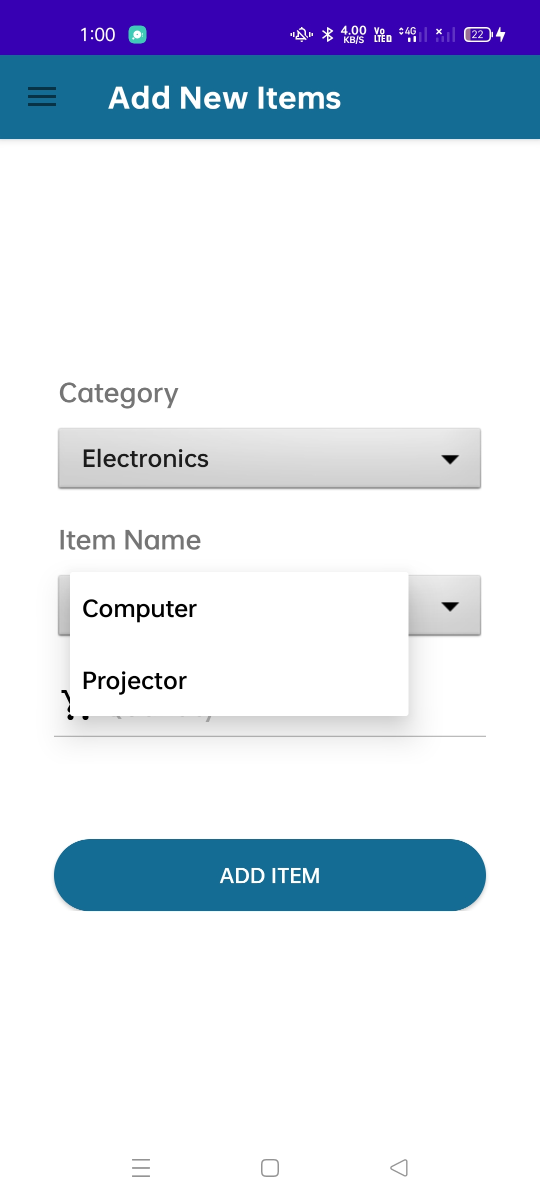
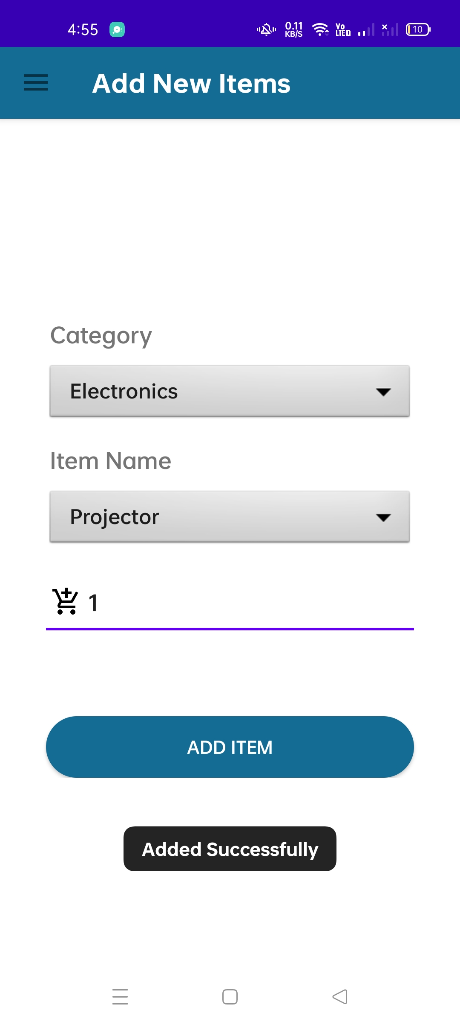
ADD ITEMS
Admin can add new items to the item stat table according to availability of item.

Slide 15
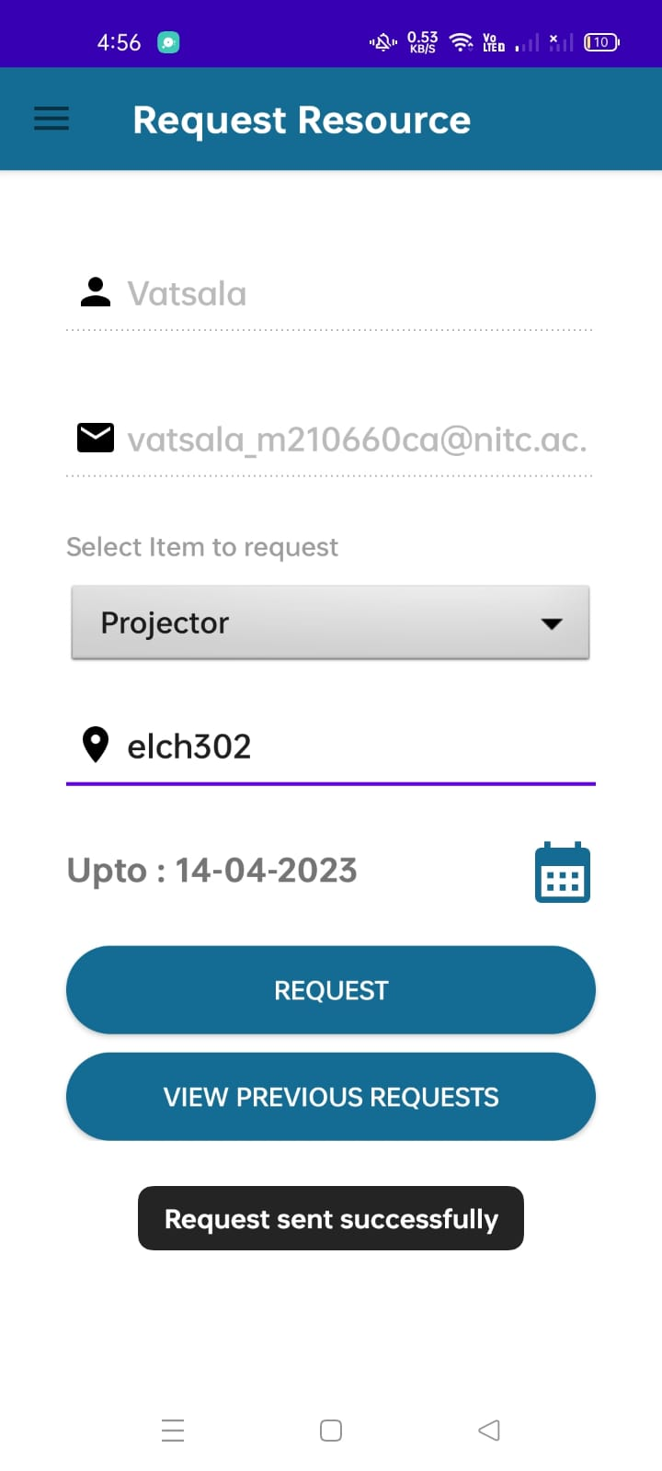
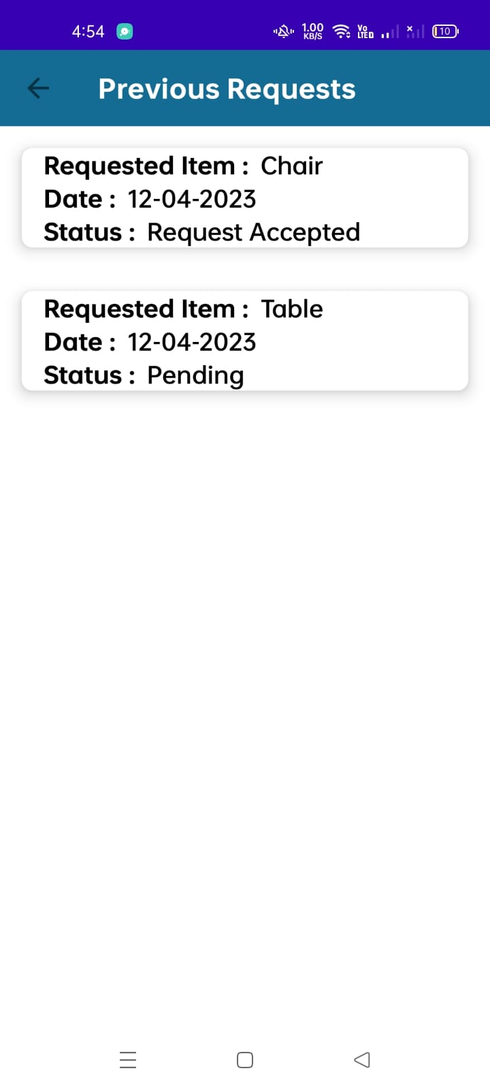
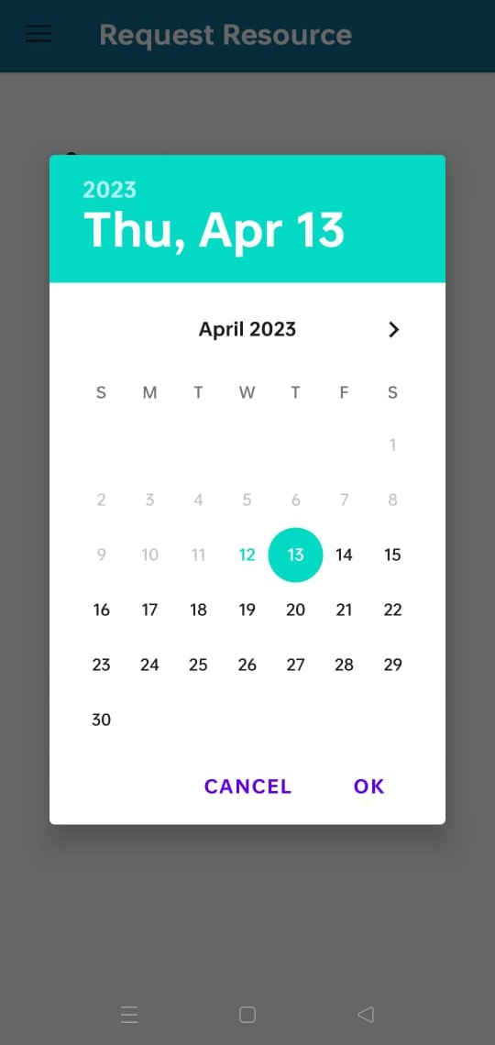
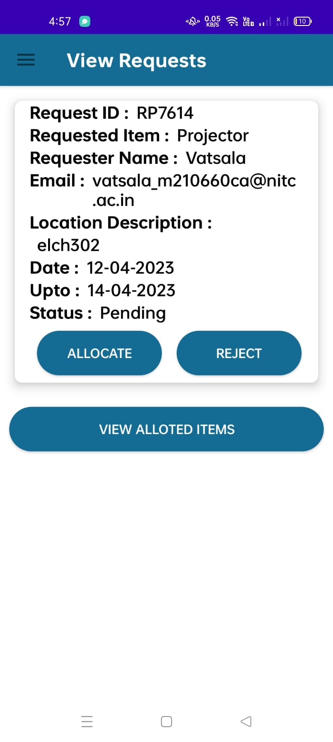
REQUEST AND VIEW RESOURCES
User can request resources and can also view their previous request.
Admin can view the details of requested resources.
USER SIDE
ADMIN SIDE

Slide 16
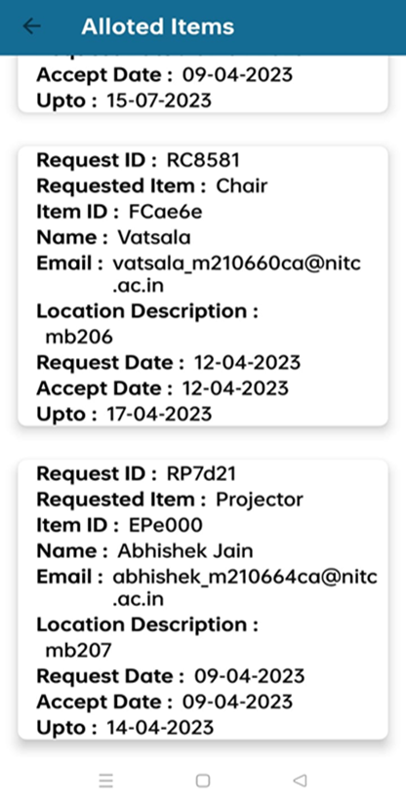
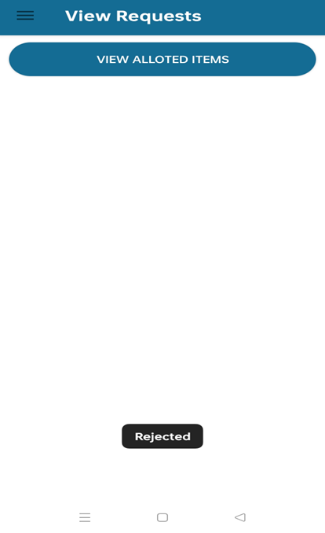
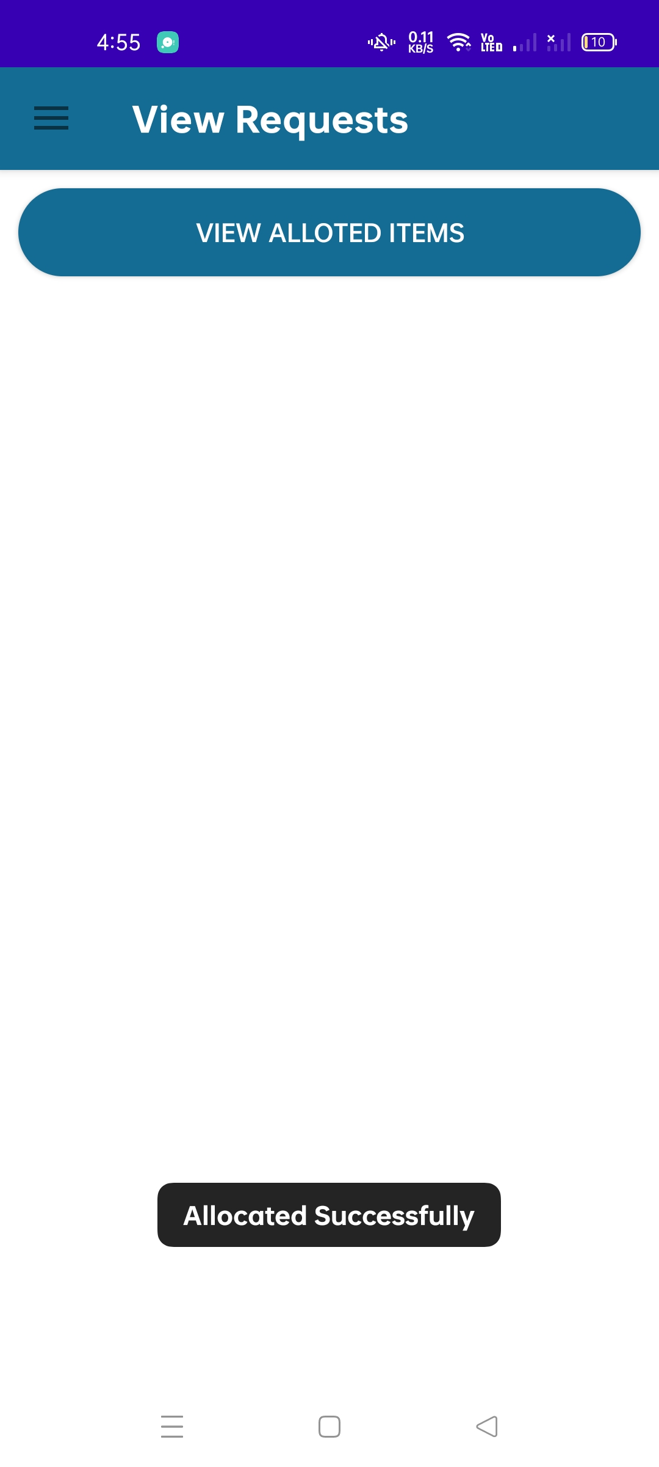
Admin can either allocate the requested resource or reject them according to the availability.
Admin can also view the details of items allocated.

Slide 17
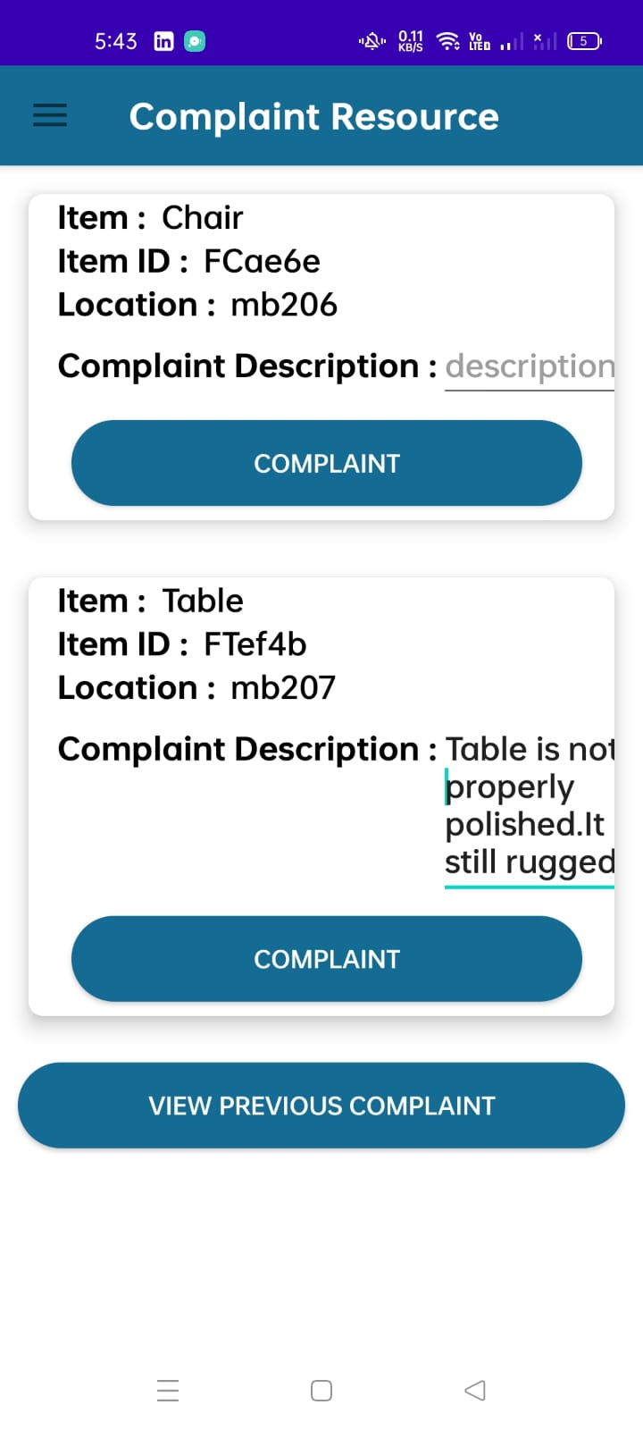
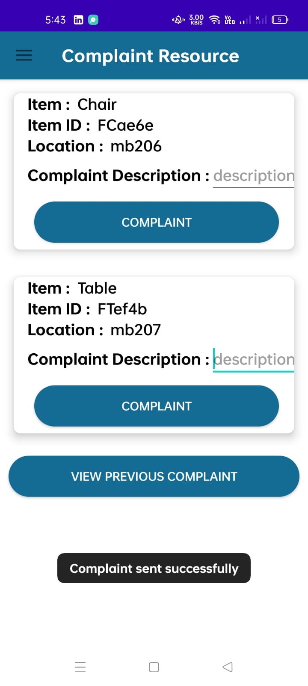
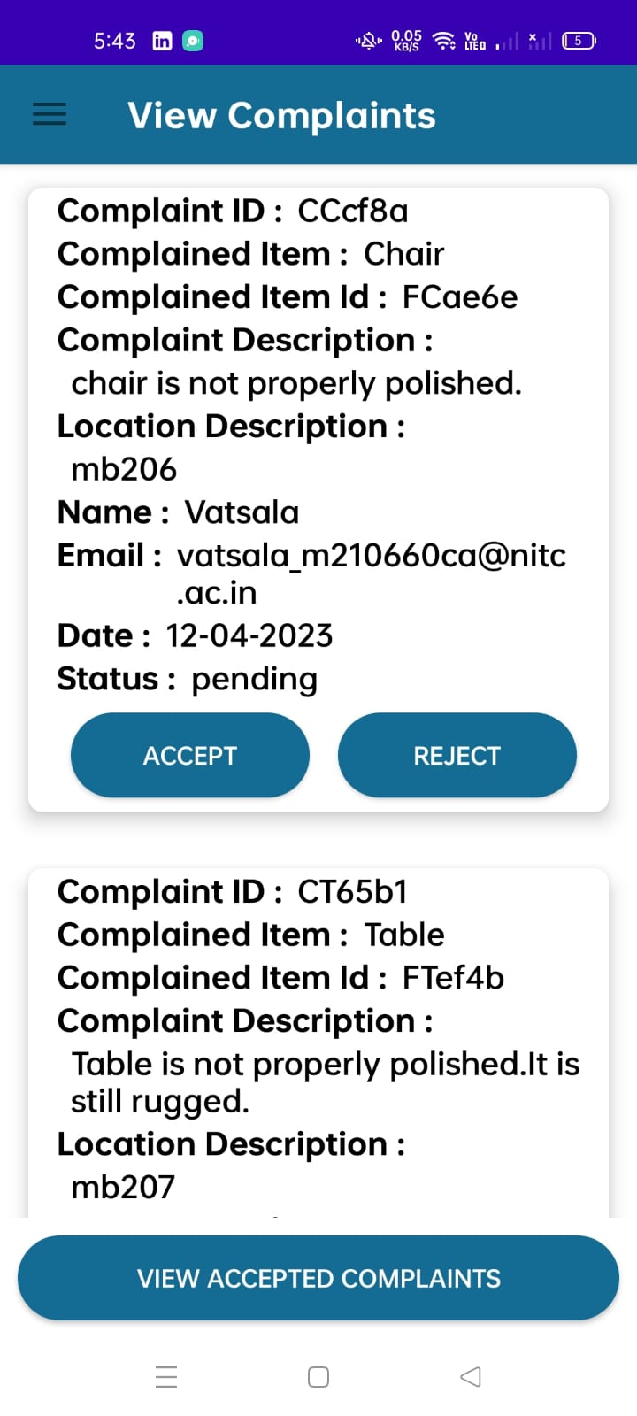
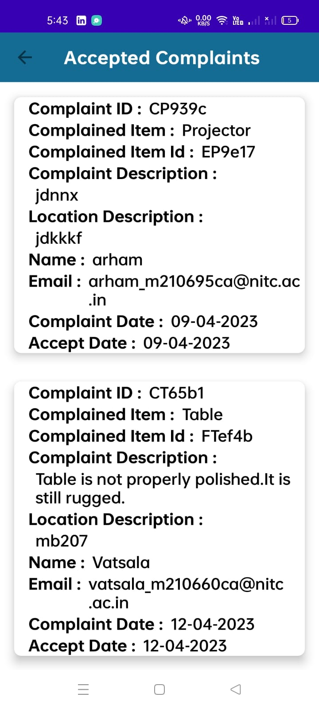
COMPLAINTS
Admin can view the complaints and can also see the details of accepted complaints
User makes a complaint for an item.

Slide 18
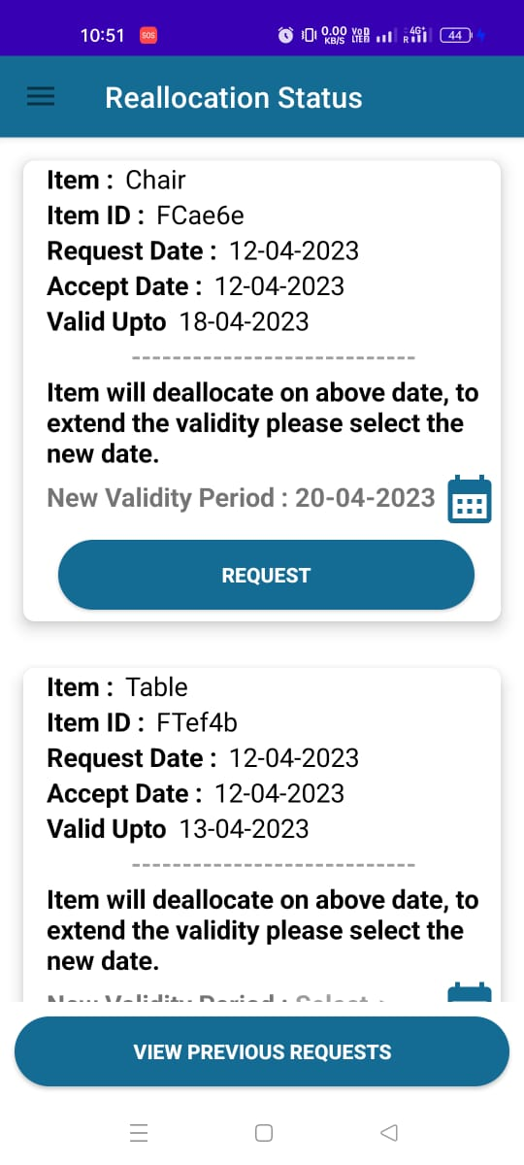
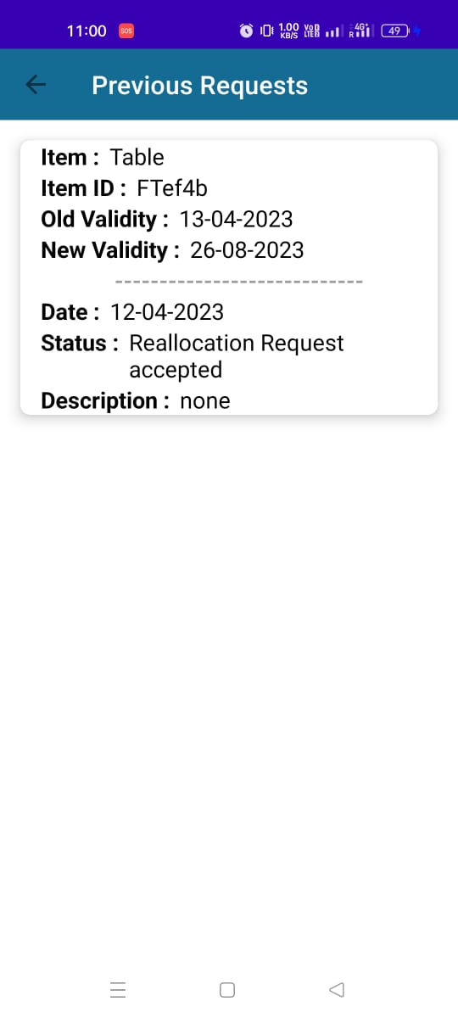
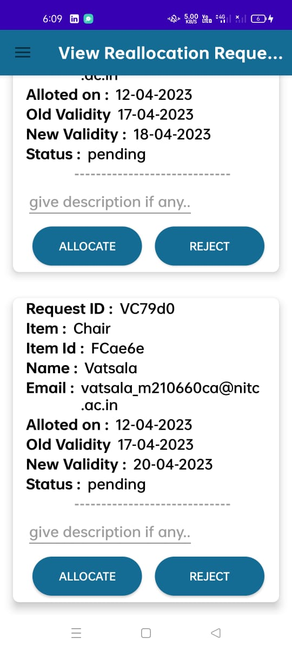
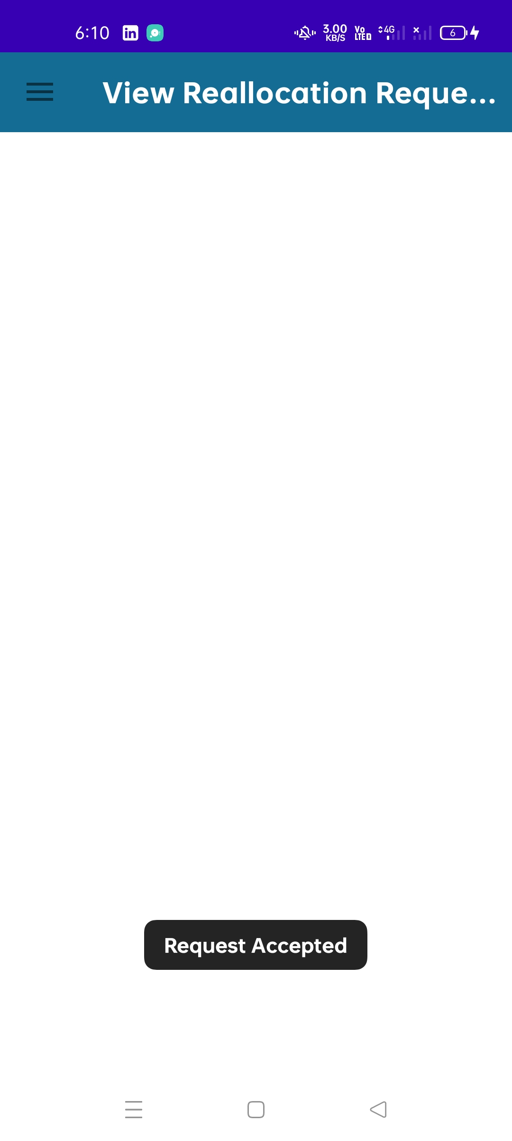
REALLOCATION OF RESOURCES
18
USER SIDE
ADMIN SIDE

Slide 19
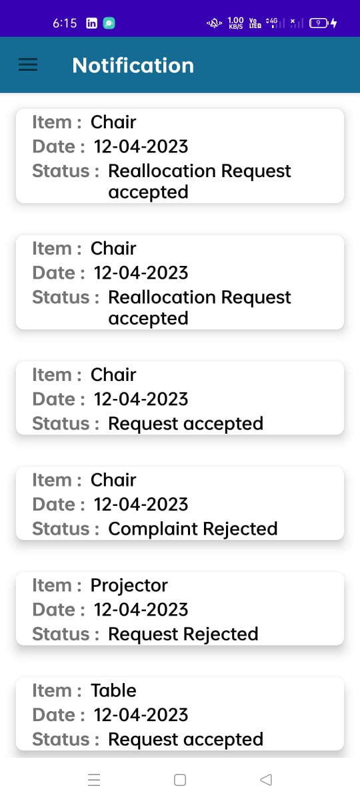
NOTIFICATIONS
USER GETS THE NOTIFICATION OF EVERY REQUEST OR COMPLAINT STATUS THAT WAS DONE BY HIM,THAT IS WHETER THE REQUEST IS ACCEPTED OR REJECTED BY ADMIN.

Slide 20
FUTURE ENHANCEMENT
New Categores of items should be added
Repair team should also be added if there is any need for item serviceing/repairing

Slide 21
THANK YOU

